Slide 1

Coventry High School
Senior Meeting
September 2024

Slide 2
Transcripts and Record Reviews
Check address
Check phone number
Review academic info on transcript such as grades, cum gpa, etc. (you can keep this-keep secure)

Slide 3
Senior Guidance Google Classroom
For senior updates and to join use:
class code: t53qifd

Slide 4
Senior Survey and What’s My Plan – 3E’s Survey?
Fill these forms out during Advisory, SH, or whenever you can in your Guidance Google Classroom!

Slide 5
3E’s
What are the 3E’s?
  Enlist, Enroll, or Employ – which are you planning for?

Slide 6
Enlist or Employ
Need help finding out more about enlisting in the military? Or finding a job?
        *Mr. Egan is a great resource!!
        *we will host a job fair this Spring

Slide 7
PLCC Adult Ed Programs
Full Time Programs:
  Auto Service Technician, Cosmetology, Esthetician, HVAC, Manufacturing Technologies, Practical Nursing
  Part Time Programs:
  -Culinary & Hospitality, EKG & Phlebotomy Technician, Emergency Dispatch, Nail Tech

Slide 8
Senior Year
Fall – college visits & college applications mailed by Thanksgiving, or sooner depending on college
Fall – financial aid – FAFSA – opens Dec.1st (check the college deadlines)
Winter – compare college & financial aid packages to select your school

Slide 9
College Rep Procedures
CHS College Fair – Thursday, Sept. 12th – see google sheet sign up shared by Mr. Egan – lots of colleges – free applications
Some college reps will be here during Advisory as well, if they cannot attend the college fair.

Slide 10
College Visit Procedures
Every student is entitled to 2 excused college visit days - & a third or more with prior approval
Parent needs to call you off that morning – saying that you are going on a college visit
You must get your College Visit Form signed at the college

Slide 11
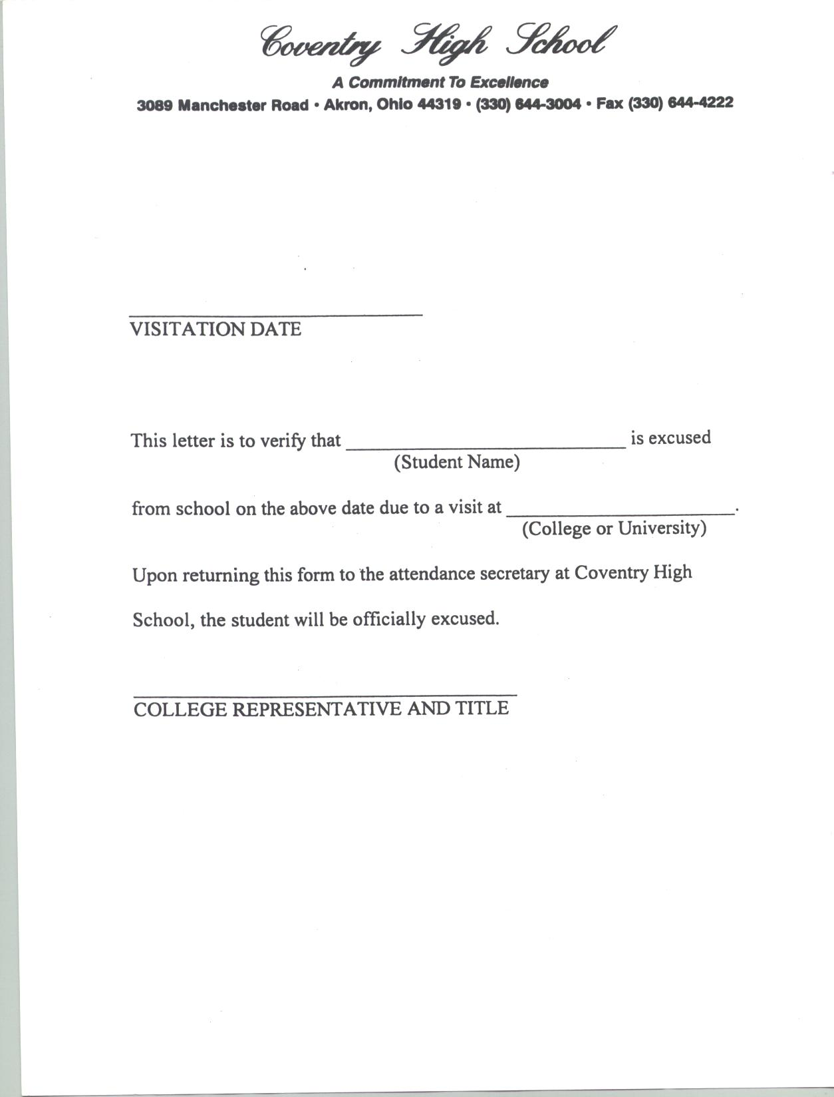

Slide 12
College Visitation Days
University of Akron –
    Call to set up individual visits or virtual
    Days for specific majors possibly
    www.uakron.edu/admissions
Kent State University –
    Call to set up individual visits or virtual
    Days for specific majors possibly
    www.admissions.kent.edu
Go to websites if interested in other college visitation days or open houses.

Slide 13
Online College Applications
Apply online – College website - Office of Admissions – Incoming freshman (undergraduate)
Signature page – for some colleges this will be at the end of your online application – be sure to print this out and bring to Guidance so we can mail transcript – or email us and ask us to mail
Fee Waivers – must have applied and been accepted for free/reduced lunch this year in order to utilize a fee waiver – some colleges are waiving fees

Slide 14
Application Deadlines
Pay close attention to the deadlines for the particular schools you are interested in!
Regular application deadline
Honors Program deadlines
Scholarship Application deadline – also is there a separate app for scholarships
Goal: All college applications in before Thanksgiving Break!!!

Slide 15
Common Application
Commonapp.org
Approx. 1000 colleges (many in OH) = 1 application
For A-L use mberentz@coventryschools.org email address
For M-Z use jhorner@coventryschools.org email address

Slide 16
College Entrance Exams
1) ACT
2) SAT
School Code: 360-030

Slide 17
ACT Test Sections
1) English
2) Math
3) Reading
4) Science
5) Writing (optional)

Slide 18
ACT Dates
October 26th (deadline Sept. 20th)
December 14th (deadline Nov. 8th)
actstudent.org
Online registration
If you have not yet retaken the ACT and still want to, you may sign up for the October/December test. Many colleges are test-optional now.

Slide 19
ACT Costs
ACT = $69.00
ACT Plus Writing = $94.00
Late Registration = add $38.00
Fee Waivers – free/reduced lunch – see Guidance at least week in advance

Slide 20
SAT Test Sections
1) Reading and Writing
2) Math

Slide 21
SAT Dates
November 2nd (deadline: Oct. 18th)
December 7th (deadline Nov. 22nd)
Go to collegeboard.org to register

Slide 22
SAT Costs
SAT = $68.00
Late Registration = add $34.00
Fee Waivers – if free/reduced lunch – see Guidance at least a week in advance

Slide 23
Financial Aid Night
Oct. 3rd – 5:30 pm – presenter will be from the University of Akron Financial Aid Dept.
FAFSA goes LIVE December 1
www.fafsa.ed.gov

Slide 24
Websites
We have put together a list of many valuable websites for you to use.
Test Prep
Career / College Search
Financial Aid / Scholarship

Slide 25
NCAA/NAIA
All potential Div. I & II athletes need to fully register with the NCAA Eligibility Center. Division III potentials only need to fill out the free profile with the eligibility center. Potential NAIA athletes should register with NAIA eligibility center.
www.eligibilitycenter.org / $100 fee to fully register, or free just for the profile part
Fee waivers available www.playnaia.org / $100 fee
Please see Mr. Egan ASAP if you have not done so already

Slide 26
Scholarships
Morning announcements
Guidance Google Classroom
Social Media
Senior Bulletin Board

Slide 27
Communication
Guidance Google Classroom
Social Media
Webpage
Morning Announcements
Guidance Bulletin Board

Slide 28
Final Thoughts
Pay attention to deadlines and details!
Proofread applications/essays.
Do everything online when possible.

Slide 29
Suicide & Crisis Lifeline
If you or someone you know needs support now:
Call 988
Text 988
Chat 988lifeline.org

